Slide 1








Redefining the Driver's Attention Gauge in Semi-Autonomous Vehicles
MWSiM’23
Montreal, Canada
Khwarizmi
Lab
November 1, 2023
Raja Hasnain Anwar*, Fatima Muhammad Anwar*, Muhammad Kumail Haider†, Alon Efrat‡, and Muhammad Taqi Raza*
*University of Massachusetts Amherst, †Meta Platforms, ‡University of Arizona

Slide 2
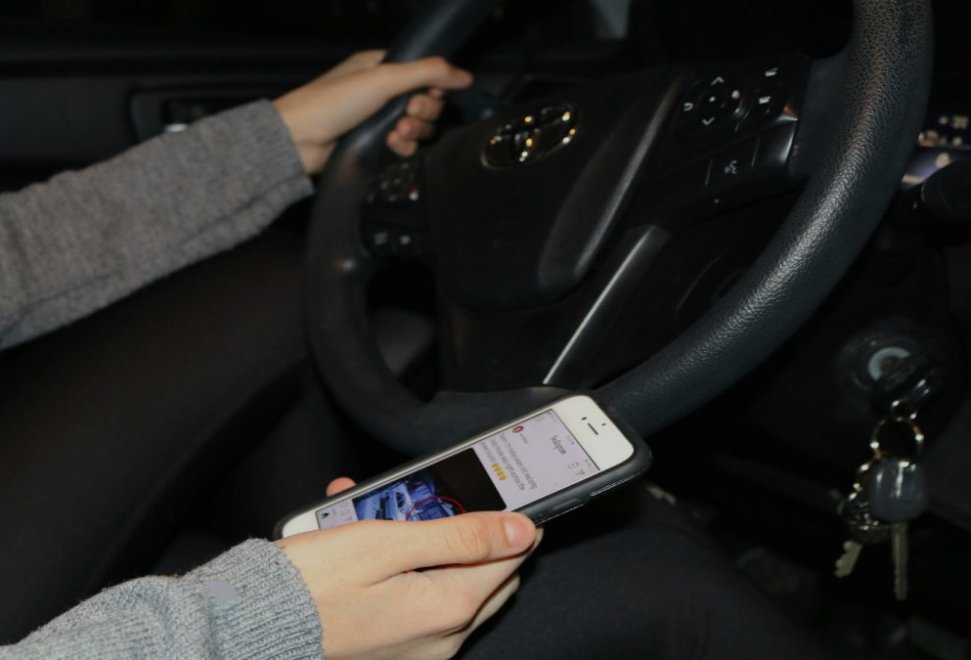
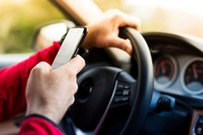
How do you kill time in stop-and-go traffic:
Catch up on the game or stay updated with the latest news?
Photos licensed under CC BY-SA-NC and CC BY-NC-ND

Slide 3
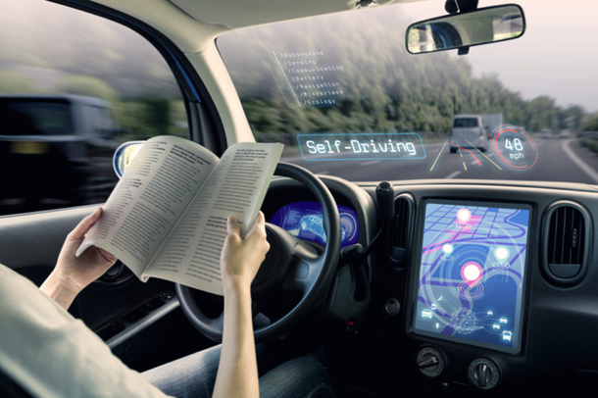
Distracted & Deadly Driving
Distracted driving accounts for 14.4% of all fatal and 22.1% of non-fatal crashes^{[1]}.
Can semi-autonomous vehicles save us?
[1] Kara Kockelman et al. An Assessment of Autonomous Vehicles: Traffic Impacts and Infrastructure Needs—Final Report. UT Austin 2017
Photo licensed under CC BY-SA-NC and CC BY-NC-ND

Slide 4
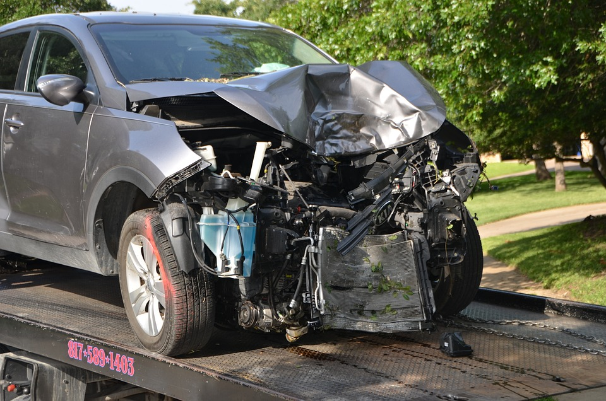
Semi-autonomous Vehicles: A driver’s aid or replacement?
There is a false sense of safety^{[2,3]}.
“Semi”-autonomous vehicles rely on humans for critical input.
A distracted driver takes an impulsive action.
Often (1.5 seconds) late^{[4]} and fatal.
[2] https://cars.usnews.com/cars-trucks/features/drivers-overestimate-self-driving-capabilities
[3] https://www.cbc.ca/news/canada/windsor/windsor-university-study-distracted-driving-1.6715465
[4] Alexander Eriksson et al. Takeover Time in Highly Automated Vehicles: Noncritical Transitions to and From Manual Control. Human Factors 2017
Photo licensed under CC BY-SA-NC and CC BY-NC-ND

Slide 5
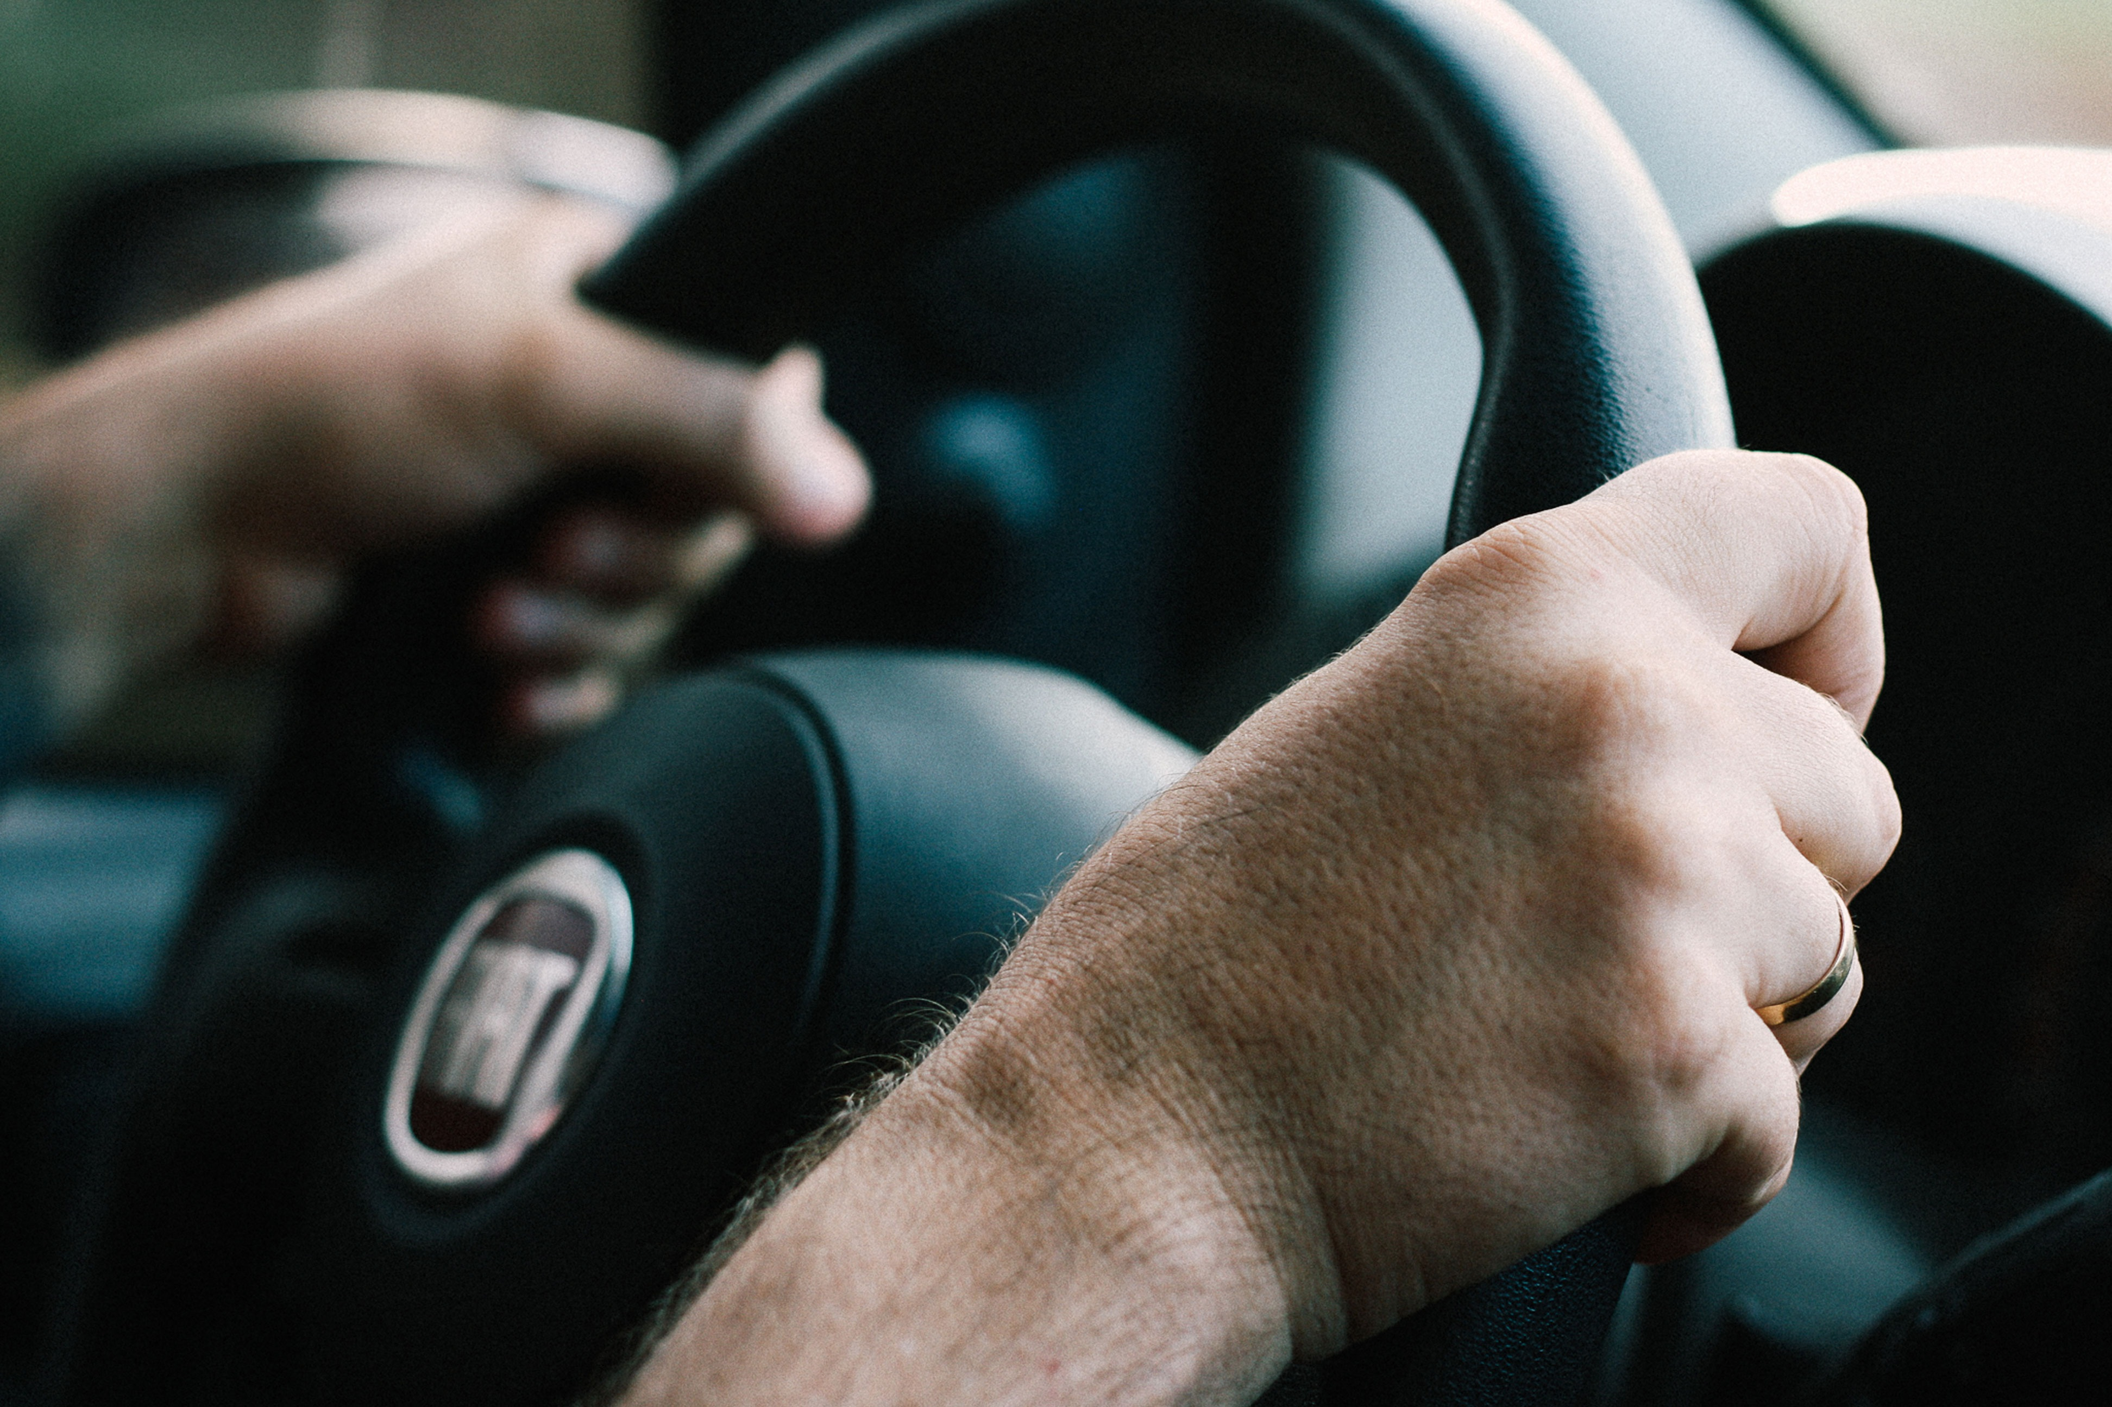
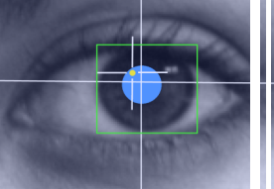
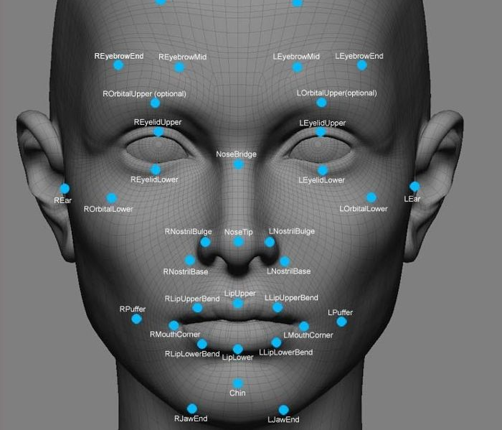
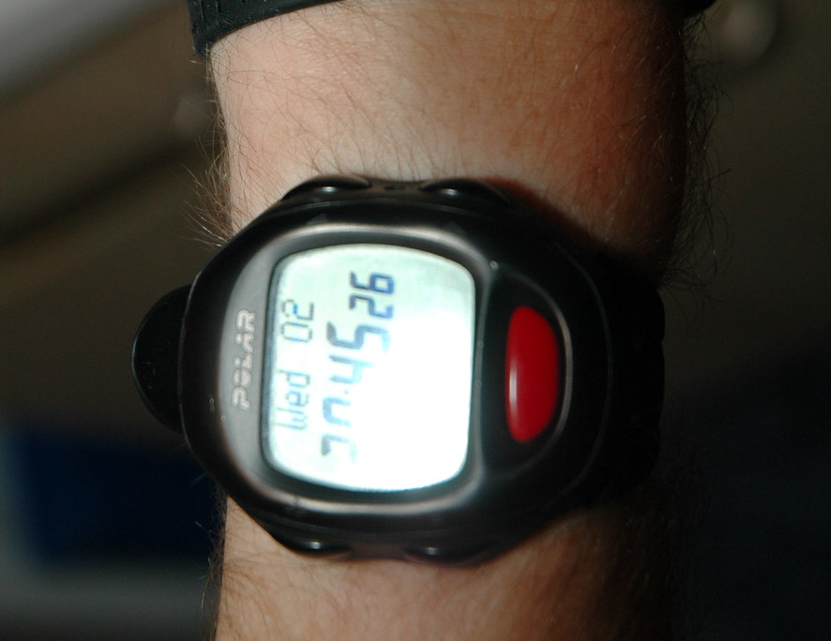
Existing Approaches to Alert the Driver
Steering wheel pressure sensors (Mecedes-Benz^{[5]})
Head and eyes tracking (Kubler et al., 2021)
Facial expressions
(Dua et al., 2019)
Wearable devices
(Wang et al., 2021)
Average human attention span is about 8 seconds!
[5] https://www.theverge.com/2020/3/3/21162310/2021-mercedes-benz-e-class-capacitive-wheel-geneva-motor-show
Photos licensed under CC BY-SA-NC and CC BY-NC-ND

Slide 6
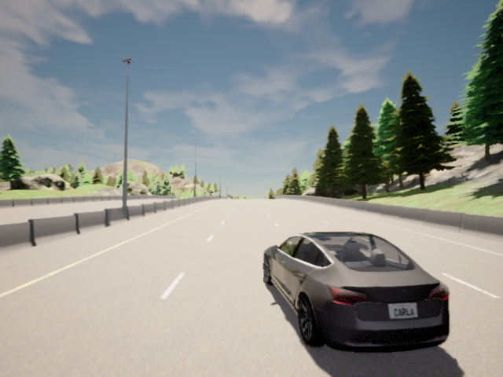
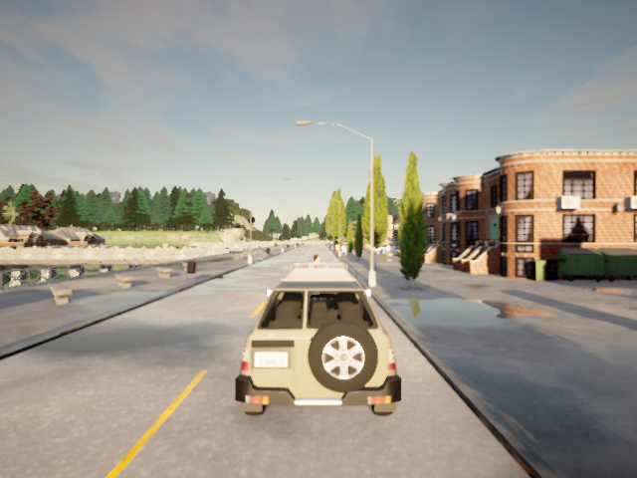
Redefining the Driver’s Attention
Drivers do not require constant attention
Vehicle processes different events differently
Not all alerts have the same priority
Reckless Driving
Sudden Stop

Slide 7
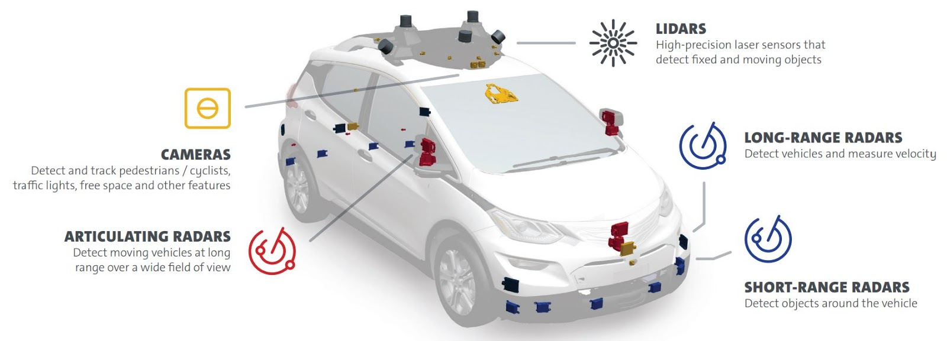
Event-based Attention
Every traffic scenario warrants a unique response from the driver.
Criticality and timeliness
Recall reckless driving vs sudden stop
Every traffic scenario engages a unique set of hardware resources.
Sensors: RGB, Depth, Radar, Lidar^{[6]}
Defining driver’s attention as a function of critical external events.
Estimating criticality and timeliness from resource usage.
General Motors
Scenario | Sensors
Jaywalking | RGB, Depth, Radar, Lidar
Reckless Driving | RGB, Radar
Sudden Lane Change | RGB, Depth, Radar
Sudden Stop | RGB, Lidar
Poor Weather | Lidar, Radar
Road Bump | RGB, Depth
[6] Self-driving Safety Report. General Motors 2018
Notes:
under the poor weather condition, the semi-autonomous vehicle tries to ensure that the vehicle should not depart from its lane; whereas, the sudden appearance of a foreign object (e.g., a pedestrian jaywalking or an animal crossing the road), the vehicle applies the brakes and/or changes its course safely. These are critical scenarios that mandate that the driver should be attentive in a timely manner. However, two critical events cannot be of the same importance. For example, avoiding a foreign object is more critical than steering the vehicle within its lane on a bumpy road. Therefore, it is important to alert the driver according to the criticality of the event.

Slide 8
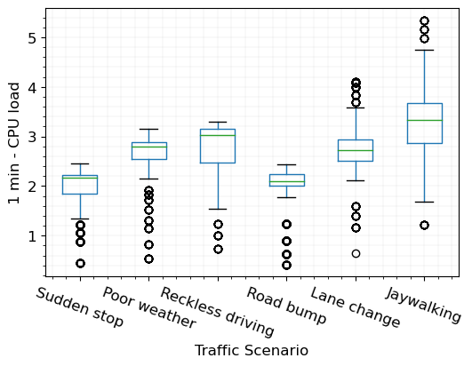
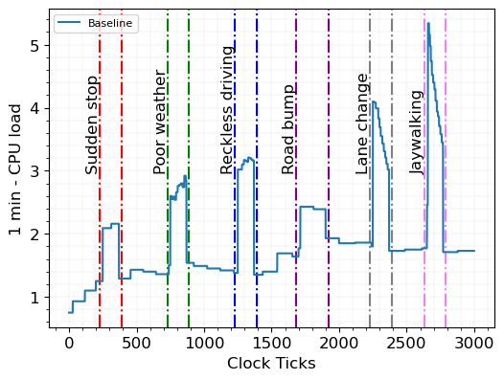
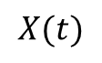
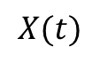
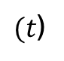
Events as Unique Processes
Separate Simulations
Joint Simulations
$$X(t)$$
$$X(t)$$
$(t$)

Slide 9
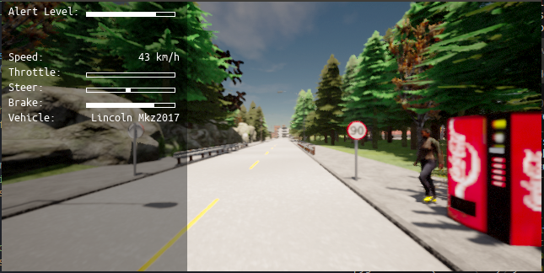
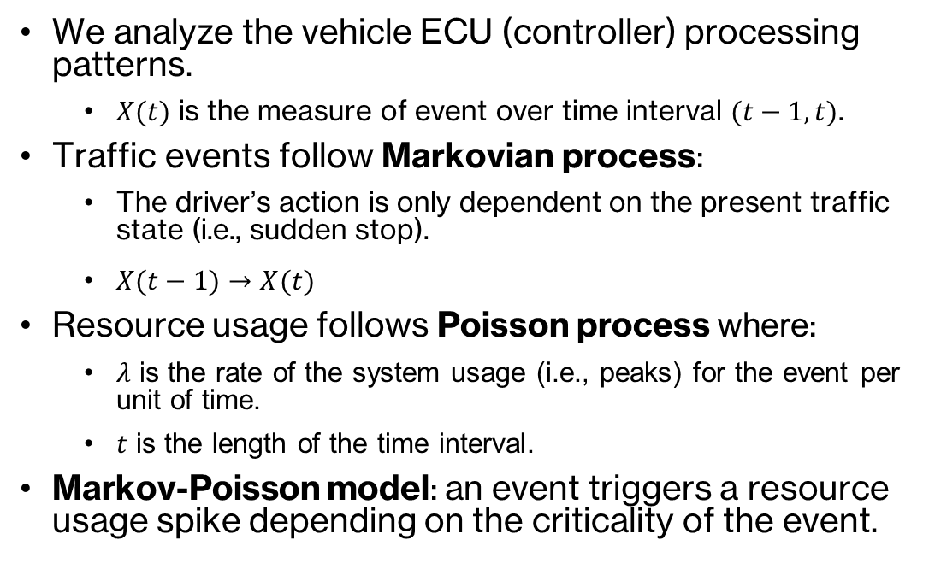
Modeling Traffic Events into Attention Feedback
Event
We analyze the vehicle ECU (controller) processing patterns.
$X(t)$ is the measure of event over time interval $(t−1,t)$.
Traffic events follow Markovian process:
The driver’s action is only dependent on the present traffic state (i.e., sudden stop).
$X(t−1)→X(t)$
Resource usage follows Poisson process where:
𝜆 is the rate of the system usage (i.e., peaks) for the event per unit of time.
𝑡 is the length of the time interval.
Markov-Poisson model: an event triggers a resource usage spike depending on the criticality of the event.
Response
Jay Walking

Slide 10
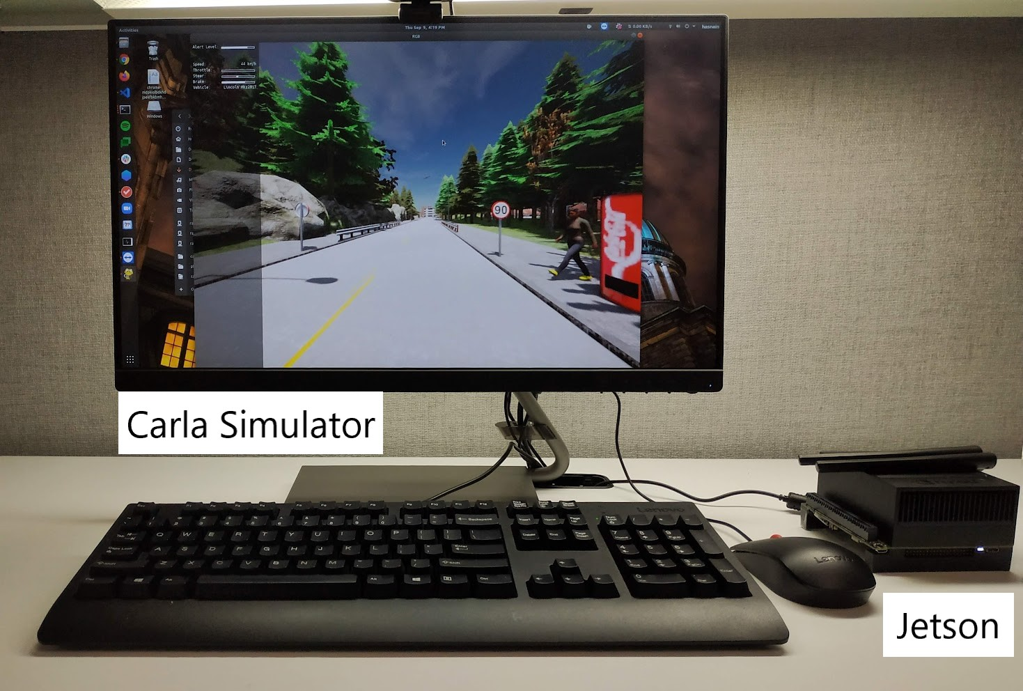
Experimental Setup
Carla simulator (0.9.11) running on a general-purpose PC.
2.8 GHz processor
32 GB Memory
ECU implemented on an NVIDIA Jetson Xavier AGX.
Workload:
NVIDIA Autopilot^{[7]} for RGB and Depth
Cylinder3D^{[8]} for Lidar
RODNet^{[9]} for Radar
[7] Bojarski et al. End to End Learning for Self-Driving Cars. NVIDIA 2016
[8] Zhu et al. Cylindrical and asymmetrical 3d convolution networks for lidar segmentation. CVPR 2021
[9] Wang et al. Rodnet: Radar object detection using cross-modal supervision. WACV 2021

Slide 11
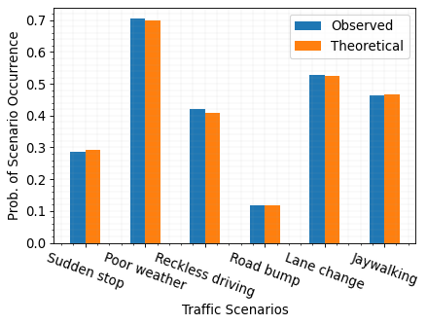
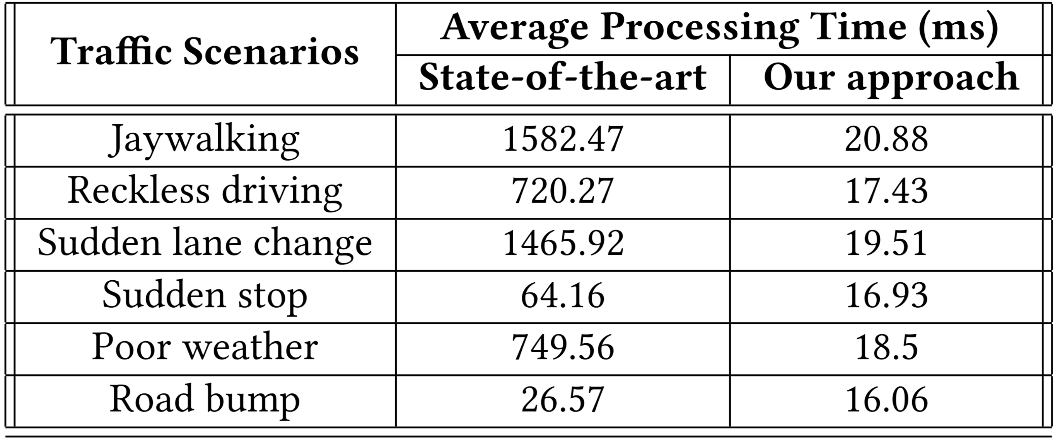
Evaluation
Likelihood Estimation of Critical Event Arrival
Timeliness of the Alert
Up to 75x faster.
The theoretical probability of an event is an average of all estimated probabilities.
Notes:
The high similarity between observed and estimated probabilities indicates that (a) our model correctly selects the appropriate 𝜆 using the present state as prior, and (b) it estimates the likelihood of occurrence of a critical traffic scenario with high accuracy and confidence.

Slide 12
Thank you for your attention!
Conclusion
Future Work
Existing driver’s attention-gauging methods are ineffective.
We propose a situation-aware driver’s attention gauge and alert mechanism.
Only engage the driver when safety-critical situation arises.
Estimation of timeliness and criticality of events using resource utilization spikes.
Alerts sharing across vehicles.
VANET integration.
Contact:
Raja Hasnain Anwar (ranwar@umass.edu) KhwarizmiLab.github.io

